Slide 1
MUSIC STORE ANALYSIS USING SQL
By Abhishek Bhattacharjee

Slide 2
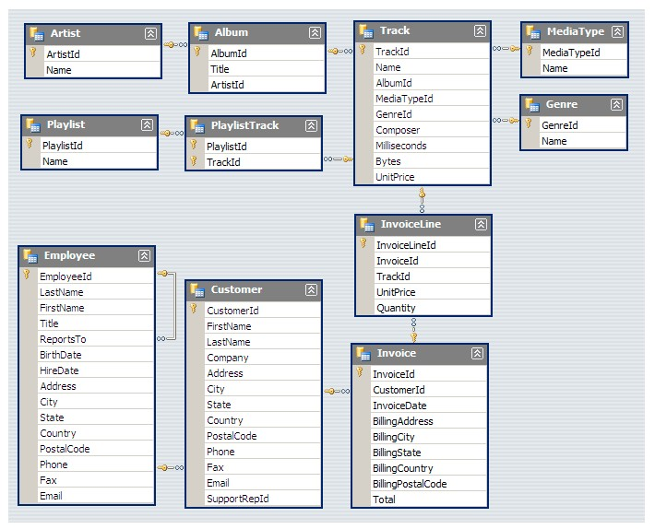
This SQL endeavour delves into the realm of music through an extensive music store dataset. Through the application of SQL queries, the objective of this project is to offer insights into diverse facets of the music industry, encompassing sales analysis, customer behaviour, and genre preferences.
SCHEMA :-

Slide 3



Slide 4

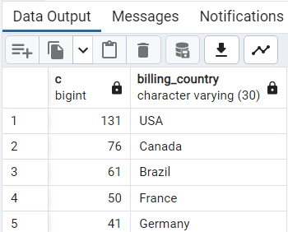

Slide 5

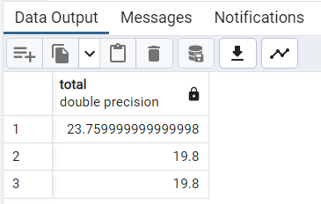

Slide 6

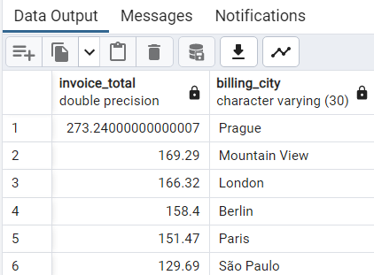

Slide 7



Slide 8
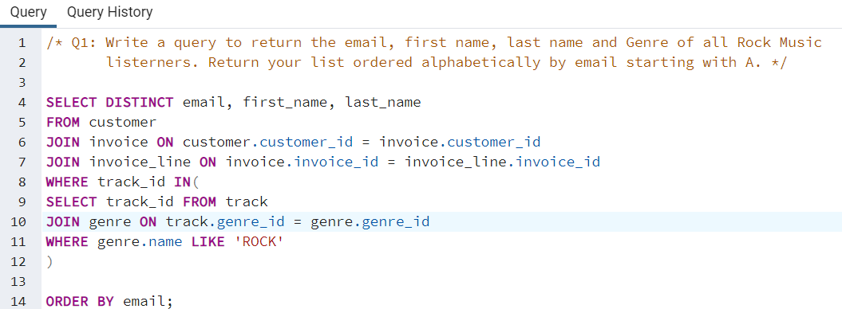
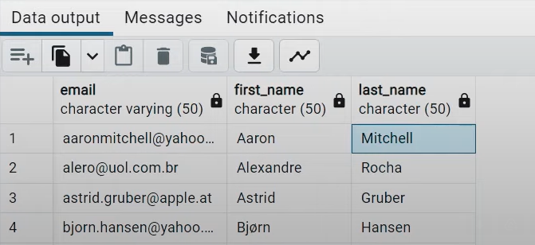

Slide 9

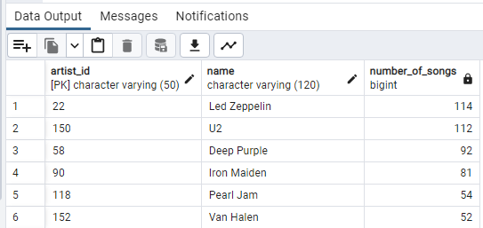

Slide 10



Slide 11
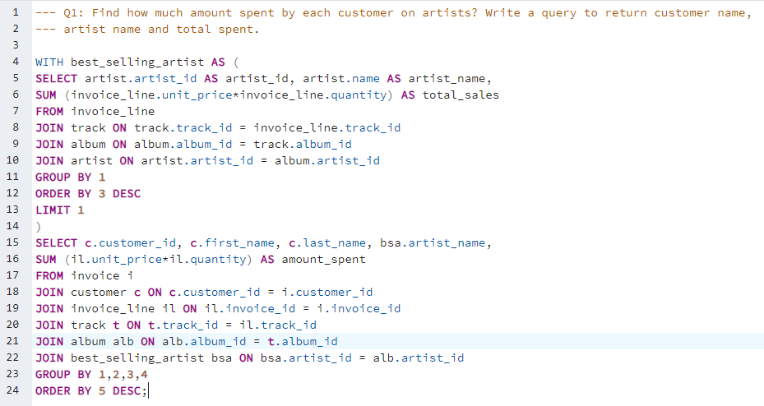


Slide 12
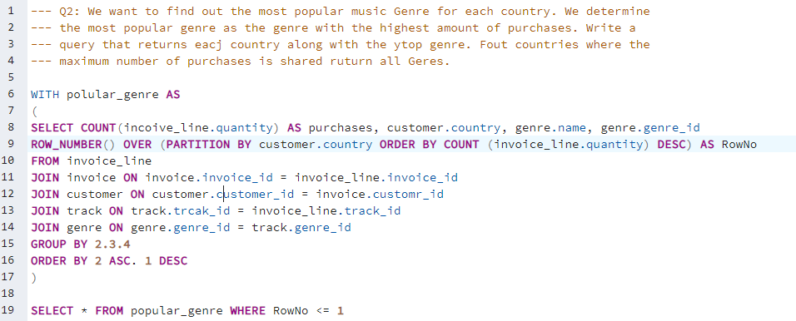


Slide 13
